Slide 1


Web Platforms
Subject Name: Platform Based Development
Subject Code: PBDV301 | PBDE401
Lecturer Name : Freedom
Department : Information Technology

Slide 2
Outline of the lesson
Objectives:
Understanding what are web programming languages.
Differentiate between front-end programming languages and back-end programming languages.
Learn and understand significant features of web programming languages.
Learn factors to consider when choosing “the most suitable” web programming languages.
Understanding the different web platform constraints

Slide 3
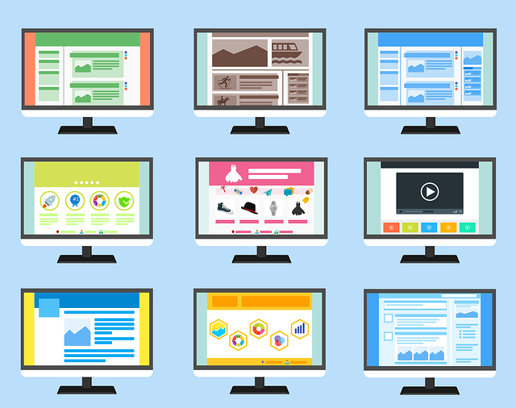
Web Programming Languages
Different web solutions (websites & Apps)
  Static websites
  Dynamic websites (web app)
  Single page applications
  Progressive web apps
  Real-time applications
  Artificial Intelligence (AI) applications

Slide 4
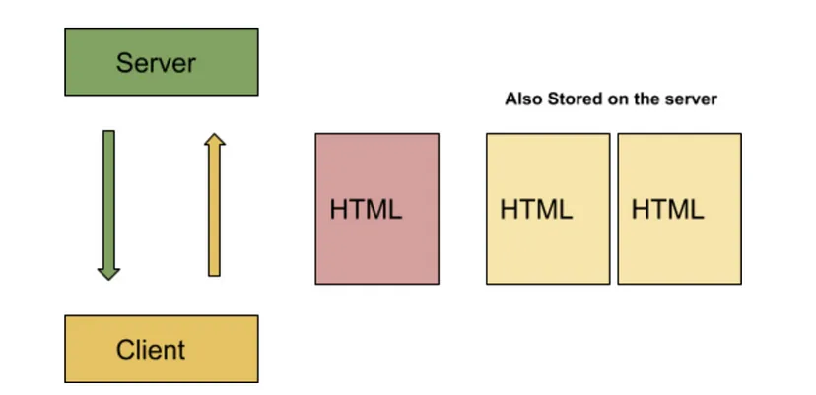
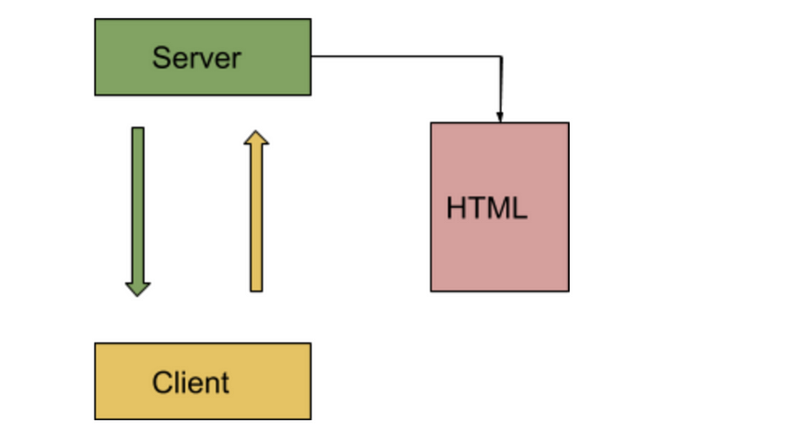
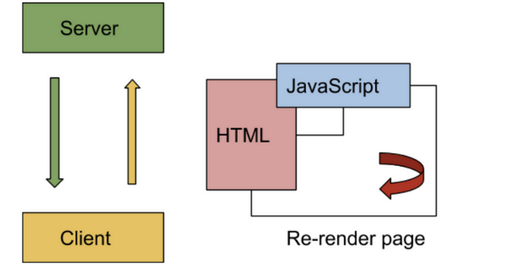
Web Programming Languages
S
  -Static websites
  -Dynamic websites/Web app
  -Single Page applications

Slide 5
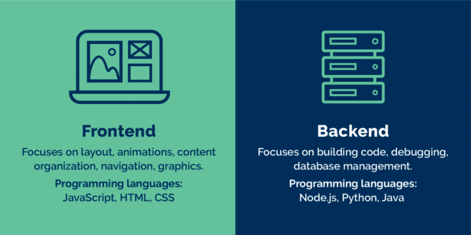
Web Programming Languages
Difference between client-side and server-side

Slide 6
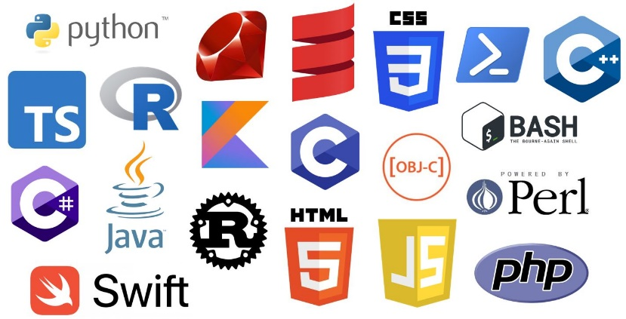
Web Programming Languages
Right tool for the right job
  Knowing different programming languages
Any programming language that assists in the development of a web application or website is a web programming language.
  HTML5
  Java
  Python
  C#
  Ruby
  CSS3
  JavaScript etc.

Slide 7
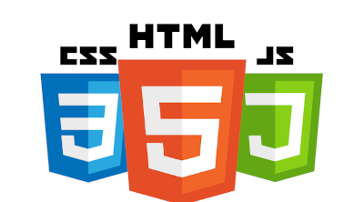
Web Programming Languages
Front-end development (User/Client-side)
  Tools
    Code editors – E.g. VS Code, Atom, Sublime Text etc.
    IDE (Integrated development environment) – Visual Studio, Eclipse, PyCharm
    Terminal (Command Interface)
    Browser
    Github
    Basic web technologies :
      HTML – foundation
      CSS - appearance (extension SAAS)
      JavaScript- response to user input (dynamic)
    Advantages – Fast , free, easy to use, customizable

Slide 8

Web Programming Languages
Front-end - other important concepts
Responsive design
Version control
Package managers

Slide 9
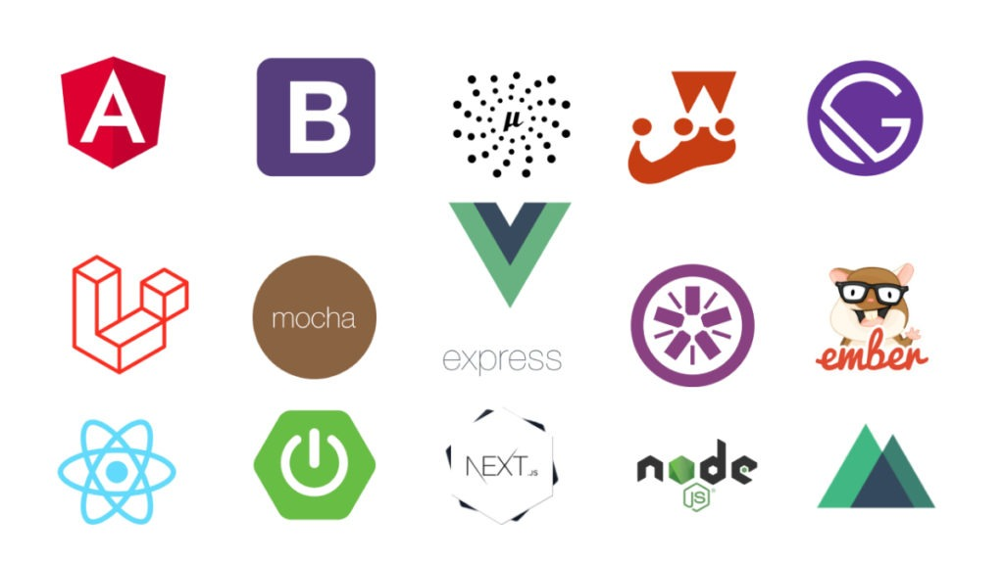
Web Programming Languages
JavaScript - Front-end and Back-end
  (Also create mobile cross-platform apps (Android and iOS)
  Frameworks

Slide 10
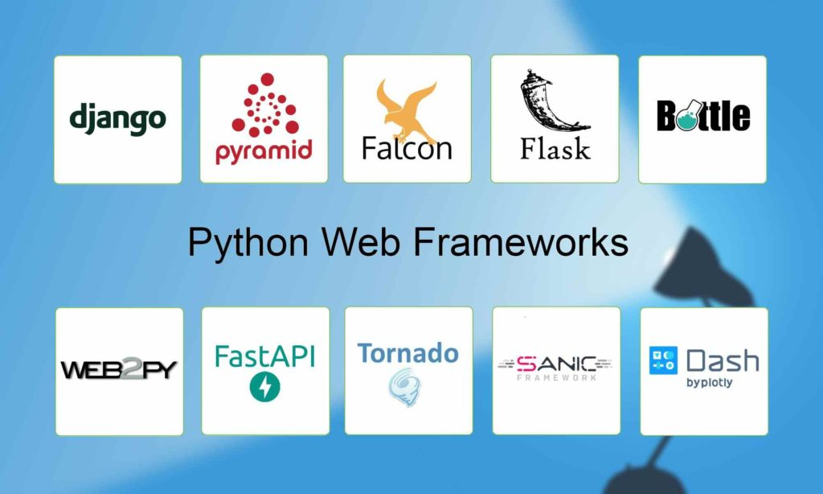
Web Programming Languages
Python - Front-end and Back-end
  Frameworks

Slide 11
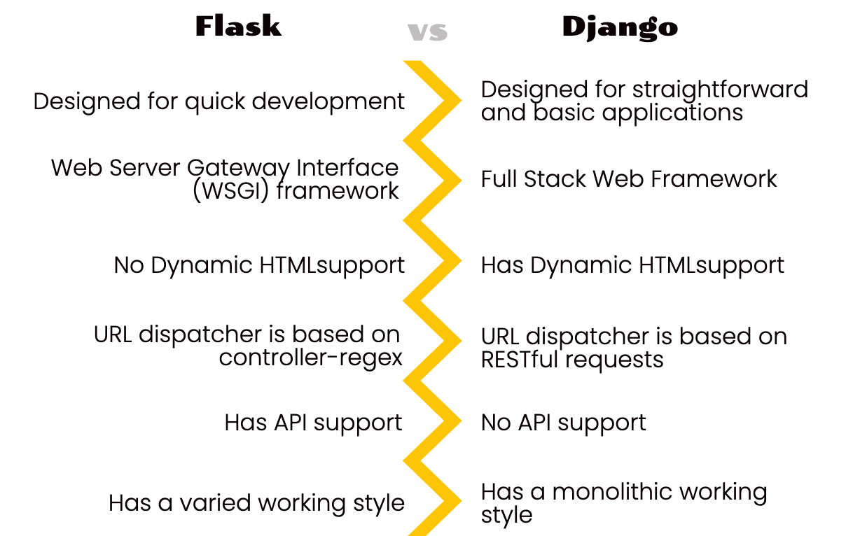

Web Programming Languages
Python - Front-end and Back-end
  Frameworks

Slide 12
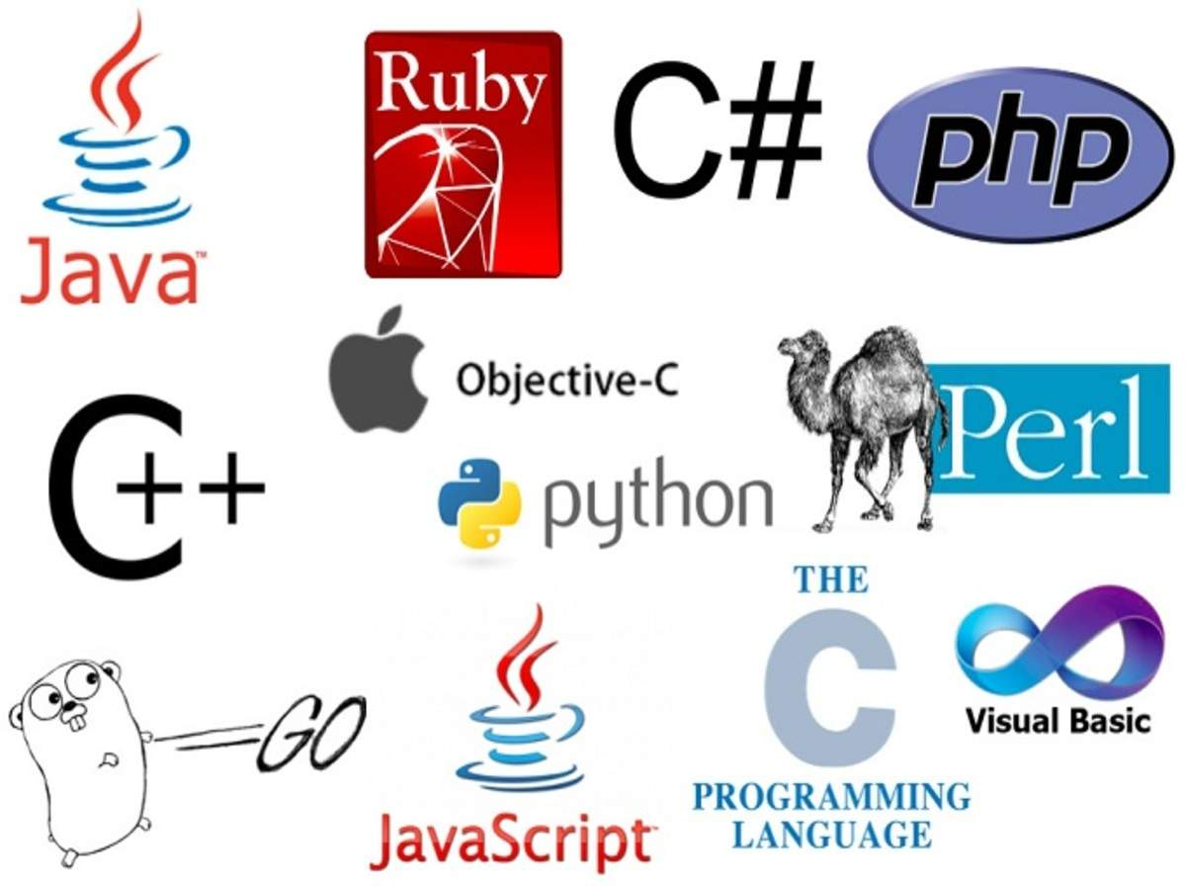
Web Programming Languages
Back-end development (Server-side)
  Tools
    IDE – E.g. Visual Studio, NetBeans, Eclipse.

Slide 13

Web Programming Languages
Suitable web programming languages
There are a number of parameters (factors) to consider:
  Project requirements (e.g. type of application and features)
  Popularity,
  Demand,
  Budget,
  Performance,
  Support,
  Learning curve,
  Reliability, and more.

Slide 14

Web Platform Constraints
Server dependency
Browser incompatibility
Lack Responsiveness
Internet reliance
Reduced Speed / Performance
Less Security
No visibility
Restricted Functionality
Compliance with data related laws

Slide 15
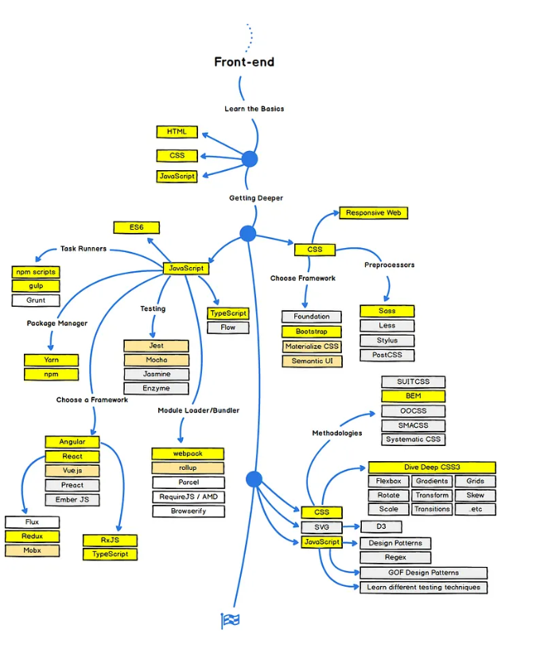
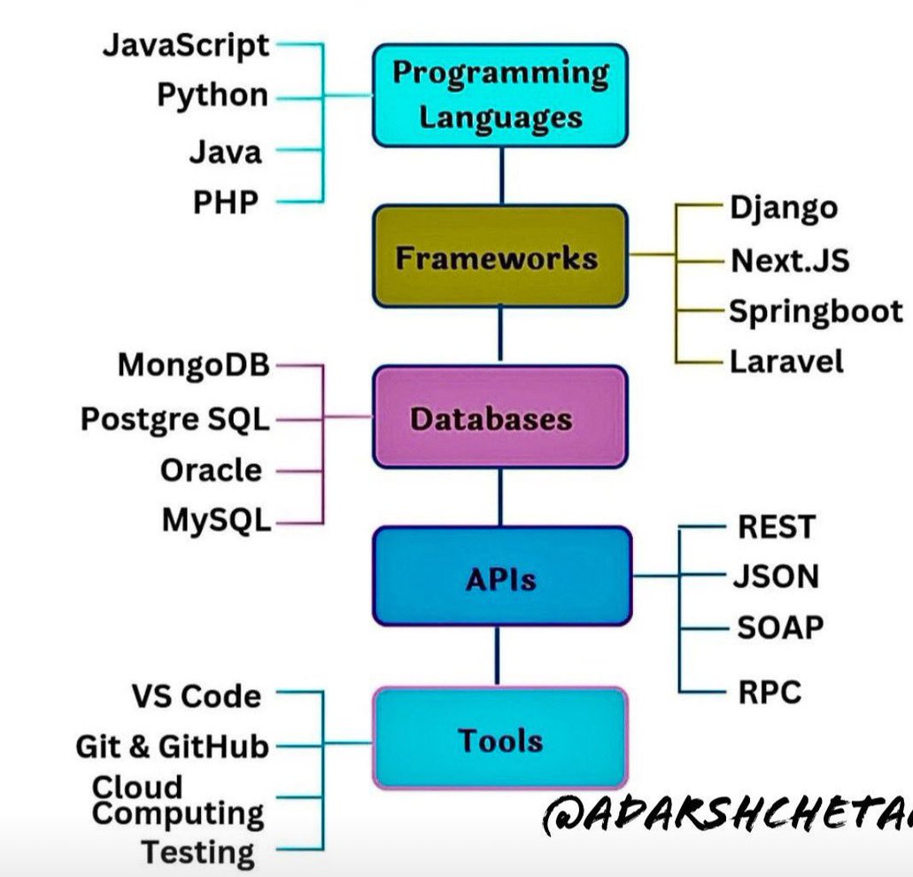
Road Map

